Slide 1


Slide 2
Summary
Paper a collaboration of:
  the Stanford Center on Longevity, and
  the Society of Actuaries’ Committee on Post-Retirement Needs and Risks (CPRNR)
Authored by Steve Vernon, Research Scholar at the Stanford Center on Longevity. svernon@stanford.edu
Stochastic forecasts by Dr. Wade Pfau, professor of retirement income at The American College
Fiduciary discussion by Fred Reish, Bruce Ashton, and Joshua Waldbeser at Drinker Biddle & Reath LLP
CPRNR formed a Project Oversight Committee chaired by Sandy Mackenzie
Published September 2013

Slide 3
Today’s Agenda
Summary of retirement planning environment
Review of current and future trends at employer-sponsored DC plans, including retirement income
Summary of methods to generate retirement income from savings
Analysis of retirement income generators (RIGs)
  Features – pros and cons
  Projections of amount of retirement income at retirement and beyond
  Projections of remaining wealth
Stay in employer plan or IRA rollover? Pros and cons
Putting it all together: Retirement income strategies
VII. Next phases of analysis
Notes:
SUMMARY OF RECENT PAPER – COLLABORATION SOA, Stanford Center on Longevity
Take the retiree’s perspective – how to best generate retirement income
Will address Issues involved with generating retirement income from DC plans
Summarize landscape in DC plans as evolving wrt retirement income

Slide 4
I. Retirement Planning Environment
Risks facing retirees
Quantifiable risks
  Market/sequence of returns
  Longevity
  Withdrawal rates too high
  Inflation
  High fees
  Insurer insolvency
  Liquidity
  Inadequate protection for surviving spouse
Behavioral risks
  Inadequate understanding of issues with generating income
  Temptation to spend more today
  Mistakes, fraud, or cognitive decline
  Poor/biased advice
  Inability to assess and self-execute
Notes:
Retirement phase more complex than accumulation phase.
Need to go beyond asset allocation, selection of securities or funds

Slide 5
I. Retirement Planning Environment
Decisions on retirement income made in following context
  Social Security claiming
  Existence of traditional pensions
  Deploying home equity
  Role of continued work
  Threat of high expenses for medical or long-term care
  Desire to leave a legacy
  Expected pattern of living expenses
  Amount of debt
  Level of income taxes
Notes:
While taxes are important, don’t have time to explore that topic today
Will focus on generation of income in retirement

Slide 6
II. Review Trends Employer-Sponsored DC Plans
Retirement Income Options Not Yet Widespread in Employer-Sponsored DC Retirement Plans
From Society of Actuaries’ report: The Next Evolution in Defined Contribution Retirement Plan Design
Notes:
Current practice is for employer-sponsored DC plans to pay lump sums to retiring employees, but trends point to that changing in the future.

Slide 7
II. Review Trends Employer-Sponsored DC Plans
Interest Heating Up with Retirement Income Solutions in Employer-Sponsored DC Retirement Plans
Accounts in 401(k)/DC plans significant part of boomers’ retirement resources
Employers expressing no interest in retirement income solutions in AonHewitt survey dropped from 57% to 27% between 2012 and 2013
In 2009 DOL promulgated safe harbor regulations on annuities in DC plans
DOL considering regulations on longevity annuities, retirement income statements in DC plans
Recent papers on retirement income from professional groups:
  Society of Actuaries: The Next Evolution in DC Retirement Income Design
  American Academy of Actuaries: Risky Business – Living Longer Without Income for Life
Notes:
Will see increasing interest in retirement income in coming years

Slide 8
II. Review Trends Employer-Sponsored DC Plans
DC Plan Investment Menu Design
at Sophisticated Employers
Passive funds, drive fees as low as possible
Limited menu of core index funds in domestic, small cap and international stocks, bonds, REITs
Target date funds that package the core index funds
Employees can elect target date funds or mix their own asset allocation
Notes:
Influenced by academic research showing underperformance of actively managed funds
Influenced by behavioral finance research to keep it simple

Slide 9
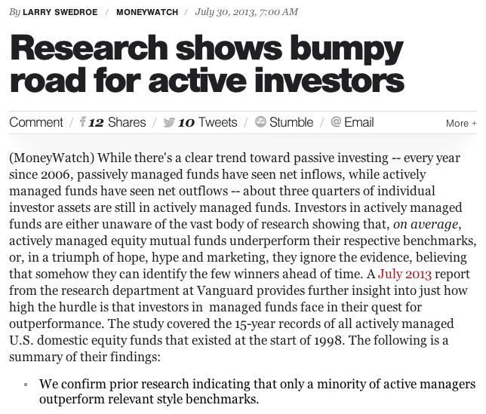
II. Review Trends Employer-Sponsored DC Plans
Academic Research Shows Underperformance of Actively Managed Portfolios
Notes:
2012 S&P Indices vs Active Scorecard
Last year underperformance by 63% large cap, 80% midcap, 67% small cap
Last 3 years 86% large cap, 80% midcap, 67% small cap
Last 5 years 75% large cap, 90% midcap, 83% small cap
Int’l more mixed 44% 1 year, 56% 3 years, 74% 5 years
LT gov bonds 69% 1 year, 98% 3 years, 94% 5 years
Intermediate bonds 31% 1 year, 58% 3 years, 50% 5 years

Slide 10
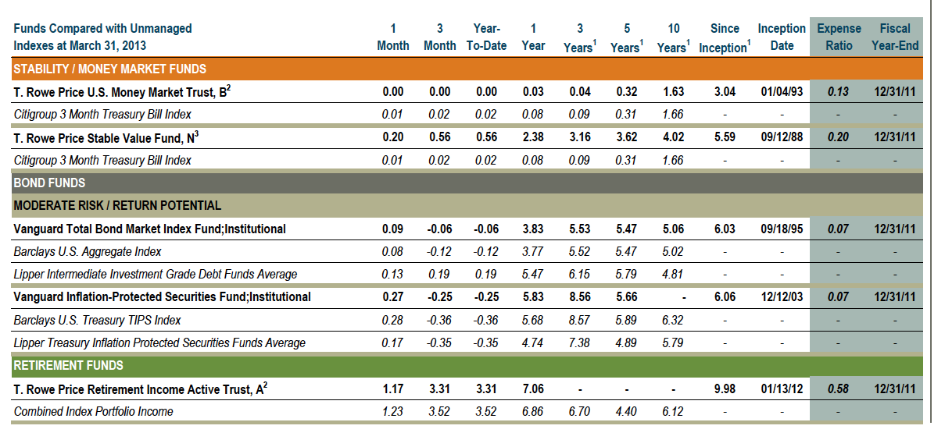
II. Review Trends Employer-Sponsored DC Plans
Emphasis on Transparency and Disclosure
Notes:
Savvy employees and retirees will see how much they are paying in expenses and investment performance comparison to indices

Slide 11
II. Review Trends Employer-Sponsored DC Plans
Fiduciary Issues
ERISA defines prudent man rule for all fiduciary decisions, including selection of retirement income generators in DC plans
Emphasis on reasonable and documented process, not on outcomes
Safe harbor rules go beyond general prudent man rule; exist for:
  Selecting annuities in DC plans
  Advice provided in DC plans
Default retirement income option significant fiduciary decision
  No regulatory guidance on default design
  De facto default: QDIA combined with IRS RMD
Notes:
Summary of callout box in paper by ERISA attorneys

Slide 12
III. Three Types of
Retirement Income Generators (RIGs)
Investment income: Invest savings, spend investment income, leave principal intact
Systematic withdrawals: Invest savings, withdraw principal cautiously to avoid outliving principal (but no guarantee)
Annuity: Purchase guaranteed lifetime income from insurance company
Many possible variations and combinations with each approach
Notes:
For our purpose today, will focus on SWPs and annuities.
Investment income could be considered subset of SWPs (plus have challenges in DC plans w/ RMD)

Slide 13
III. Variations on
Retirement Income Generators (RIGs)
Systematic withdrawals | Annuities
Constant amount, real or nominal (4% rule) | Single premium immediate annuities (SPIA)
Endowment method (constant % of assets) | Fixed deferred annuities
Life expectancy method (IRS RMD) | Variable deferred annuities
Payout over fixed period | Variable immediate annuities
 | GLWB/GMWB
 | Longevity annuities

Slide 14
III. Features of RIGs in DC Plans
In-plan vs. out-of-plan
Products vs. advice vs. guidance
At retirement vs. leading up to retirement
Notes:
Discuss examples of each

Slide 15
III. Retirement Income Generators (RIGs)
Sample of Current Providers
In-plan | Out-of-plan
SWPs through managed accounts: Financial Engines, Guided Choice | SPIA bidding platforms: Fidelity, Income Solutions, Schwab, Vanguard
SPIA bidding platforms: Income Solutions | Managed payout funds: Fidelity, Schwab, Vanguard
GMWB: Great-West, Pru, Transamerica
GMWB bidding platform: AllianceBernstein
Group immediate or deferred fixed income
SWPs combined with deferred annuities: UBS
Notes:
Advisors can either view these as competition, or can consider as tools to use for their clients

Slide 16
IV. Analysis of RIGs
Evaluation Criteria for RIGs in DC Plans
Amount of income
Lifetime guarantee
Pre-retirement protection
Post-retirement potential for increases
Post-retirement protection
Access to savings
Inheritance potential
Investment control
Withdrawal control
Notes:
This is a lot of detail, for advisors and plan designers
Next slide shows summary of how various RIGs meet these criteria

Slide 17
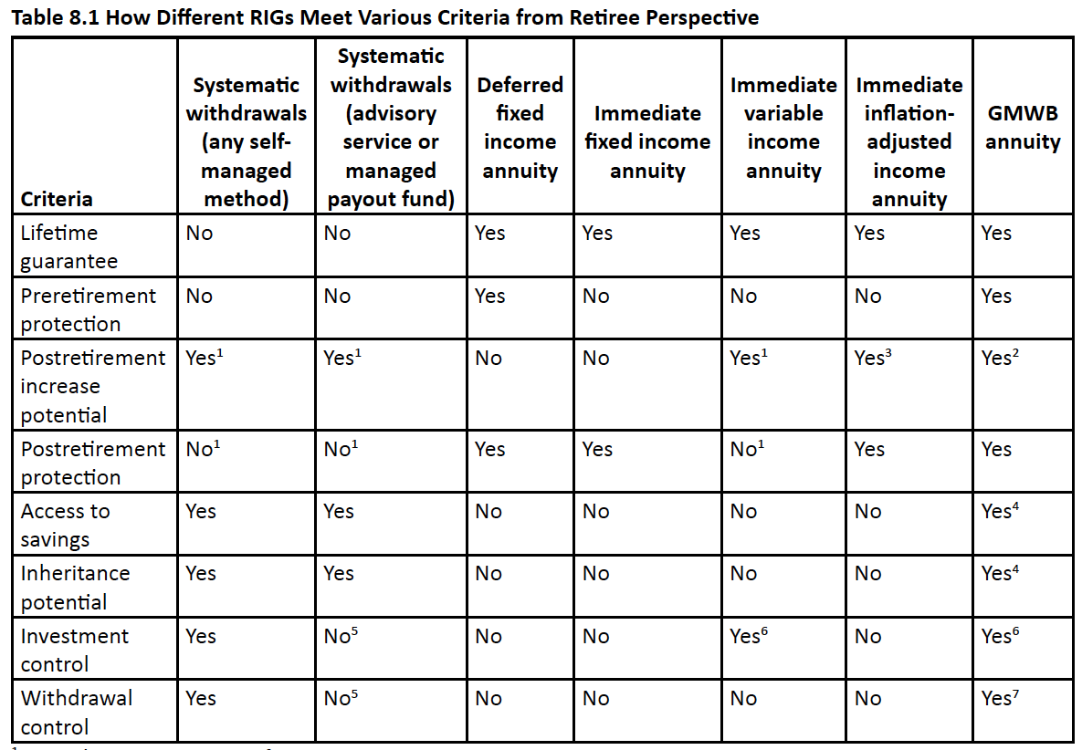
IV. Analysis of RIGs
Evaluation Criteria for RIGs in DC Plans
From Society of Actuaries’ report: The Next Evolution in Defined Contribution Retirement Plan Design
Notes:
No one size fits all solution
Note there are various footnotes – didn’t have room to include, but you can see in full report

Slide 18
IV. Analysis of RIGs
Projections of Retirement Income
Stochastic forecasts of:
  Systematic withdrawals – constant amount 4% rule
  Systematic withdrawals – constant percentage 4% of assets
  Systematic withdrawals – IRS RMD
  SPIA – inflation adjusted
  SPIA – fixed
  GMWB
Assumptions
  Systematic withdrawals and GMWB assume 60/40 equity/bond allocation
  Institutional pricing
  Assumptions on inflation, investment returns and annuity pricing reflect current low-interest environment
  See Appendix for details
Forecasts prepared by Dr. Wade Pfau, professor of retirement income at The American College

Slide 19
IV. Analysis of RIGs
Projections of Retirement Income
Real retirement incomes – expected scenario 50th percentile
Flat line keeps pace with inflation
From Society of Actuaries’ report: The Next Evolution in Defined Contribution Retirement Plan Design
Notes:
Main point: Choice of RIG significantly impacts retirement income upon retirement and pattern throughout retirement
At retirement: low is $3,500 SWP RMD. High is $5,490 for fixed SPIA -- 57% higher than low value
15 years: Low is $2,918 SWP constant percentage. High is $4,159 fixed SPIA – 43% range in values
30 years: Low is $2,092 SWP constant percentage. High is$4,000 SWP constant amount – almost 100% range in values
Stochastic forecasts aren’t predictions -- they just show possibilities
Truth is that we don’t know what will happen in future with returns, inflation
Need to plan for uncertainty

Slide 20
IV. Analysis of RIGs
Projections of Retirement Income
Real retirement incomes – unfavorable scenario 10th percentile
Flat line keeps pace with inflation
Annuities
Systematic withdrawals
From Society of Actuaries’ report: The Next Evolution in Defined Contribution Retirement Plan Design

Slide 21
IV. Analysis of RIGs
Projections of Retirement Income
Real retirement incomes – favorable scenario 90th percentile
Flat line keeps pace with inflation
Systematic withdrawals
Annuities
From Society of Actuaries’ report: The Next Evolution in Defined Contribution Retirement Plan Design
Notes:
Next steps

Slide 22
IV. Analysis of RIGs
Projections of Retirement Income
Real retirement incomes – favorable scenario 90th percentile
Flat line keeps pace with inflation
From Society of Actuaries’ report: The Next Evolution in Defined Contribution Retirement Plan Design
Notes:
Main point: RIGS work differently under different scenarios
SWPs work better in favorable environments
Top 2 are SWPs.
Note four percent rule never adjusts income for favorable experience – fallacy of locking in strategy at retirement and never adjust

Slide 23
IV. Analysis of RIGs
Projections of Remaining Wealth
Expected scenario - 50th percentile
From Society of Actuaries’ report: The Next Evolution in Defined Contribution Retirement Plan Design
Notes:
Main point: Choice of RIG significantly impacts remaining wealth throughout retirement
No remaining wealth with SPIAs
GMWB fees reason for lowest values
GMWB fees exhaust savings at 28 year but income continues due to guarantees
Tradeoff of income vs remaining wealth – lower income produces higher wealth

Slide 24
IV. Analysis of RIGs
Projections of Remaining Wealth
Unfavorable scenario – 10th percentile
From Society of Actuaries’ report: The Next Evolution in Defined Contribution Retirement Plan Design
Notes:
Main point: Choice of RIG significantly impacts remaining wealth throughout retirement
No remaining wealth with SPIAs
GMWB fees reason for lowest values
Tradeoff of income vs remaining wealth – lower income produces higher wealth
Note GMWB, 4% rule exhaust savings at 20 years, while other two will never exhaust savings

Slide 25
IV. Analysis of RIGs
Projections of Remaining Wealth
Favorable scenario – 10th percentile
From Society of Actuaries’ report: The Next Evolution in Defined Contribution Retirement Plan Design
Notes:
Main point: Choice of RIG significantly impacts remaining wealth throughout retirement
No remaining wealth with SPIAs
GMWB fees reason for lowest values
Tradeoff of income vs remaining wealth – lower income produces higher wealth
Under favorable scenario 4% rule funds income and grows wealth

Slide 26
IV. Analysis of RIGs
Projections of Retirement Income
50/50 combination of inflation-adjusted SPIA, SWP-RMD
90th percentile
50th percentile
10th percentile
From Society of Actuaries’ report: The Next Evolution in Defined Contribution Retirement Plan Design
Notes:
Main point: Combination strategies might best meet needs of retirees. Relatively stable income, some remaining wealth
SOA report has this graph for each RIG analyzed
Unlabeled lines are 25th, 75th percentiles

Slide 27
IV. Analysis of RIGs
Projections of Remaining Wealth
50/50 combination of inflation-adjusted SPIA, SWP-RMD
90th percentile
50th percentile
10th percentile
From Society of Actuaries’ report: The Next Evolution in Defined Contribution Retirement Plan Design
Notes:
Main point: Combination strategies might best meet needs of retirees. Relatively stable income, some remaining wealth
SOA report has this graph for each RIG analyzed
Unlabeled lines are 25th, 75th percentiles

Slide 28
V. Stay in Employer Plan vs. IRA Rollover?
Pros and Cons
Large employers may negotiate fees and performance not available on retail basis
Examples:
  Equity index fund with 2 bps
  Stable value fund earning 3%/year, full liquidity
  SPIA transaction fees of 2% with competitive bidding
  GMWBs with insurance and investment fees totaling 150 to 200 bps
On the other hand, small employers may have 401(k) funds with 150 bps or higher
Notes:
It all depends on the lineup of the employer funds
Large employers already act as fiduciaries in selection of funds, conduct due diligence
Offer investments that can’t be found in retail environment

Slide 29
V. Stay in Employer Plan vs. IRA Rollover?
Institutional vs. Retail Pricing
Institutional pricing can make a difference
SPIAs: competitive bidding platform has potential to increase retirement incomes by 10% to 20%
GMWBs: institutional pricing can produce retirement incomes 12-1/2% to 20% higher than retail
SWPs: 50 bps vs. 150 bps
  Constant percent and RMD can result in retirement incomes 10% higher after 10 years, 21% higher after 20
  Four percent rule: savings exhausted 2-3 years earlier
From Society of Actuaries’ report: The Next Evolution in Defined Contribution Retirement Plan Design
Notes:
For SWPs, not necessarily institutional vs. retail, but low vs. high fees
Can find low retail fees and high institutional fees

Slide 30
VI. Putting It All Together
Retirement Income Strategies
Solutions combining SWPs and annuities strategies may produce reasonable compromise
  For example, cover nondiscretionary expenses by guaranteed sources of lifetime income: Social Security, pension, annuity
  Cover discretionary expenses with SWP strategy
    May justify higher withdrawal rate and/or aggressive asset allocation
  Subject of next phase of analyses by Stanford Center on Longevity
Notes:
One version of “create a floor, invest for upside”
Will team up with Wade Pfau again and produce efficient frontier analyses

Slide 31
VI. Putting It All Together
Retirement Income Strategies
Use DC assets to enable delaying Social Security to age 70
  Increase in Social Security income can be viewed as “annuity purchase” at a rate far more favorable than open market
  Analysis by Dr. John Shoven, director Stanford Institute for Economics Policy Research
  To enable, set up SWP program to replace SS benefits that are being delayed, up to 8 years from age 62 to 70
Notes:
“Parallel strategy” start SS, retirement income same time less efficient
“Series strategy” start SS later than retirement income more efficient
SS early retirement factors designed when interest rates higher, life expectancies shorter, no COLA.
SS adjustment factors more generous than actuarially fair

Slide 32
RIG Comparisons
How much annual income does $100,000 buy?
Age 65 Retirement
VI. Putting It All Together
Retirement Income Strategies
Type of RIG | Single Male | Single Female
RIG #2: Systematic w/d with 4% payout | $4,000 | $4,000
RIG #3: Monthly income, Cash Balance Plan | $7,870 | $7,870
RIG #3: Annuity purchase, fixed income | $6,458 | $6,006
Notes:
Amounts shown are for single life annuities.
Comparisons similar for joint and survivor annuities.
Lump sum from employer-sponsored defined benefit plan may not be best choice
Notes:
Example compare annuity from cash balance plan to generating income from lump sum
Participants and advisors need to do this type of comparison
It will be difficult for you to generate higher retirement income under cash balance plan if you take the lump sum.
Automatic answer “take the lump sum” may not be in best interests of retirees

Slide 33
VII. Next Phases of Analysis
Examine strategies combining SWPs and SPIAs using efficient frontier analysis
Does delaying Social Security extend efficient frontier?
Practical considerations with combining SWPs and longevity annuities
How can retirement income be protected in period leading up to retirement?
  Fixed deferred annuities
  GMWB annuities
  Target date funds
Behavioral finance considerations the next frontier in plan design

Slide 34

DISCUSSION and QUESTIONS

Slide 35
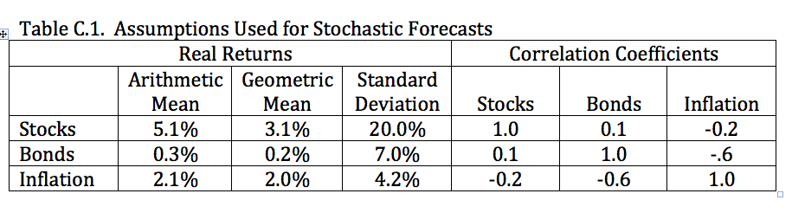
Appendix: Assumptions for Stochastic Forecasts
Institutional Pricing
Annuity purchase rates as percent of assets:
5.49% fixed SPIA
3.57% inflation-adjusted SPIA
4.50% GMWB
For 100% J&S, both age 65
SWP investment expenses: 50 bps
GMWB investment and insurance expenses: 150 bps
Notes:
Assumptions for institutional pricing
Representative of returns late 2012, early 2013
Equities S&P 500
Bonds intermediate term government

