Slide 1
Beyond Actual / Table:
New directions in experience studies
SOA Life and Annuity Symposium
Sess. 55: Individual Life Mortality
Brian D. Holland, FSA, MAAA
Tuesday, May 9, 2017

Slide 2
Purpose: address common experience studies issue
Actual / Table: how reports have worked
Actuals / Tables: ‘7580, 2001CSO, VBTyy, ...
Implication: actuals are table * a/e factor
Often not bad
The issue we know we have
Mix-of-business issue
a.k.a. "Simpson's Paradox"
A/E might give misleading results - just because of mix of business
A way to address issue: first steps
Multivariate models
Many approaches possible
Start with the more familiar models
2
Notes:
2

Slide 3
How might that look? Let’s try a model.
  A model for illustration purposes
  Adjustment factors to VBT2015
    underwriting structure/class
    Issue age group
    duration group
    whether post-level-term
    insurance plan
    Fits 100% Actual / Model claims count in each subcategory – by definition
    GLM; Poisson family; log link
    Data: 2003-13, where UW class known, from MIB to ILEC 2016/09
Questions to consider
How do adjustment factors compare to A/Table ratios?
Does the model tell the story better?
Does the model address the mix-of-business issue?
Is the model too simple, or too complex?
3
Notes:
You could get the factors with goalseek in a spreadsheet. But: statistical software gives extra information.

Slide 4
Why this model?
Pro
Adjustment factors easy to understand and communicate
Factors easy to compare to A/Table
Known weaknesses
Could overadjust: qx > 100%
if several adjustment factors push it up somewhere
Variable selection process
Model fit facts
* When have a factor: actual / model = 100%
* Could do in spreadsheet with goal seek
In real practice: must decide on factors: which combinations
4

Slide 5
Model output – how it looks
“Coefficients” are logs of the factors: are coeff of indicator function, making model linear
Significance test: p-values
 | coef | std err | z | P>|z| | [95.0% Conf. Int.] | Factor = exp(coef)
Intercept | 0.237 | 0.037 | 6.455 | 0.000 | 0.165 0.309 | 1.267
C(class_key)[T.NS 2 2] | 0.338 | 0.005 | 62.447 | 0.000 | 0.328 0.349 | 1.402
C(class_key)[T.NS 3 1] | -0.327 | 0.010 | -33.082 | 0.000 | -0.346 -0.307 | 0.721
C(class_key)[T.NS 3 2] | -0.111 | 0.009 | -12.291 | 0.000 | -0.129 -0.093 | 0.895
C(class_key)[T.NS 3 3] | 0.199 | 0.007 | 27.310 | 0.000 | 0.185 0.213 | 1.220
C(class_key)[T.NS 4 1] | -0.374 | 0.011 | -34.067 | 0.000 | -0.396 -0.353 | 0.688
C(class_key)[T.NS 4 2] | -0.139 | 0.011 | -12.536 | 0.000 | -0.16 -0.117 | 0.870
C(class_key)[T.NS 4 3] | 0.005 | 0.013 | 0.381 | 0.703 | -0.020 0.030 | 1.005
C(class_key)[T.NS 4 4] | 0.293 | 0.009 | 31.123 | 0.000 | 0.275 0.312 | 1.340
C(class_key)[T.SM 2 1] | -0.076 | 0.009 | -8.059 | 0.000 | -0.095 -0.058 | 0.927
C(class_key)[T.SM 2 2] | 0.221 | 0.008 | 27.019 | 0.000 | 0.205 0.237 | 1.247
duration_group[T. 2] | -0.049 | 0.015 | -3.292 | 0.001 | -0.079 -0.02 | 0.952
duration_group[T. 3] | -0.103 | 0.014 | -7.166 | 0.000 | -0.131 -0.075 | 0.902
duration_group[T. 4-5] | -0.186 | 0.013 | -14.512 | 0.000 | -0.211 -0.161 | 0.830
duration_group[T. 6-10] | -0.241 | 0.012 | -20.173 | 0.000 | -0.264 -0.218 | 0.786
duration_group[T.11-15] | -0.277 | 0.012 | -22.823 | 0.000 | -0.301 -0.254 | 0.758
duration_group[T.16-20] | -0.347 | 0.013 | -27.364 | 0.000 | -0.372 -0.322 | 0.707
… | … | … | … | … | …
5

Slide 6
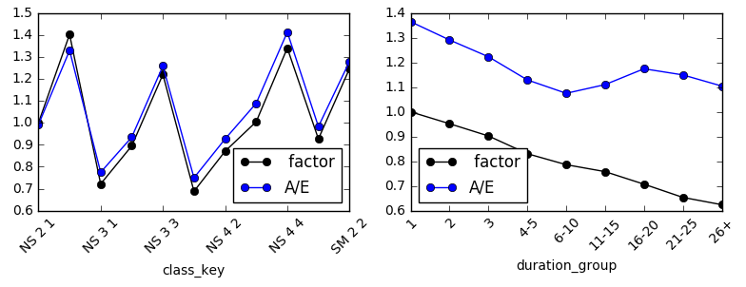
Factors vs Univariate A / Table:
How different are they?
A / T for 16-20 is over 6-10. But: factors have more reasonable shape.
There’s a serious mix-of-business issue
in A / T.
A / T splits look like adjustment factors, but aren't.
Adjustment factors across categories:
fit simultaneously
give a similar but sometimes different picture.
often less extreme
no double-counting of effects
6

Slide 7
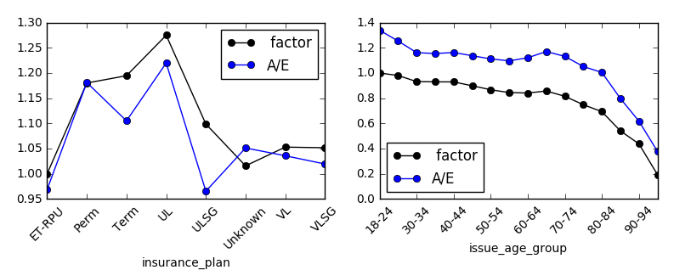
By insurance plan and issue age group
Term, ULSG factors not similar to A / T
By issue age group: shapes are more similar
7

Slide 8
A / Table vs adjustment factor – why the difference ?
Average factors weighted by VBT2015 expected: to see where to dig
Mix of business issue = Simpson’s Paradox
Average factors for those odd segments:
 | Duration band |  | Product
 | 6-10 | 16-20 | Perm | Term
Duration group | 78.60% | 70.70% | 71.80% | 79.70%
Class structure (class key) | 106.50% | 123.40% | 128.20% | 101.60%
Insurance plan | 118.10% | 120.20% | 118.00% | 119.50%
Issue age group | 86.00% | 87.30% | 86.30% | 88.60%
Post-level term indicator | 100.20% | 101.50% | 100.00% | 102.00%
Perm is older, more in 16-20, more 2-class
Perm, Term close
Note – no face factor – is correlated with product
16-20 has much higher average UW class factor
Perm has much higher average UW class factor
8

Slide 9
Durations 6-10 vs 16-20:
Difference is in class mix vs class factor:
Class mix by VBT2015 expecteds
9
Notes:
Mix by 2015VBT expecteds since have to adjust those

Slide 10
Term vs Perm:
Difference is in class mix vs class factor:
Class mix of VBT2015 expecteds
10

Slide 11
Term vs Perm:
Difference in durational mix vs factor
Durational mix of VBT2015 expecteds
11

Slide 12
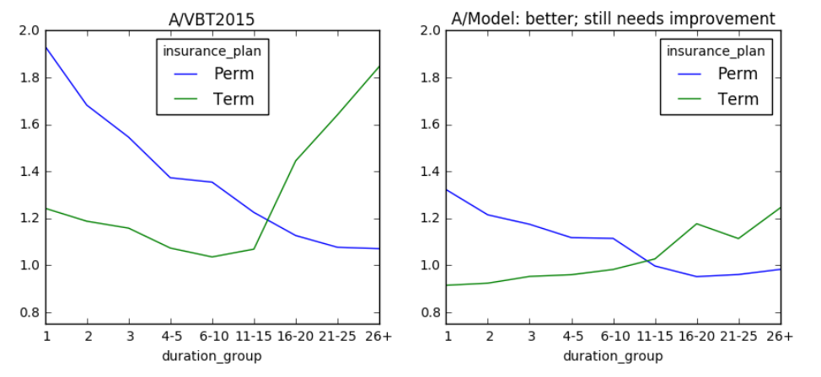
Compare A/Model: Perm, Term by duration
Model is much better than VBT2015 - but could be better.
Could be another mix-of-business issue.
Slope different by product, but could be driven by face, underwriting class – we need more factors
12

Slide 13
Where this leaves us
Strengths
We summarize data more effectively.
We avoid double-counting of A/Table ratios
Communication of factors is intuitive
Weaknesses
Must choose model to present
Remaining difference from model
Imposed model in advance
Factor choice issue - iterative variable selection process
Should add slope, product cross combinations? Duration, band cross combinations?
Remember: slope is layered on top of VBT2015 slope
13

Slide 14
Hopes and challenges for the ILEC
Hopes
– Better communication of results compared to splits
Challenges
– Where to draw the line in model complexity
– Cultural change
– More judgement and expertise involved
Longer-term hopes – more advanced methods
Nonlinear methods
Bayesian nonparametric methods, dimension reduction methods
  – data tells us the shape of things
14

Slide 15
Beyond Actual / Table:
New directions in experience studies
Thanks for your
interest

