Slide 1
Nominations and Elections Process
Society of Actuaries

Slide 2

About the Nominations and Elections Process
Learn how we elect a president-elect and five Board members each year
Get insights on the process for nominations, petitions and voting
Gain an understanding of how your voice counts with shaping the SOA’s direction and strategic plan

Slide 3

Eligible Voting Members
Fellows and associates who have been members of the SOA for five years or more

Slide 4
About Our Volunteers

Slide 5

Governance and Policy Committee
Identifies and appoints members to the Nominating Committee in the fall each year
Reviews Nominations and Elections Processes and Policies
Comprised of five-six fellows
Reports to the SOA Board

Slide 6
Nominating Committee
Nominates candidates for election, in accordance with SOA policies
Each serves a three-year term, up to two terms maximum
In fall each year three new committee members are appointed and three members who completed their term roll off
Comprised of nine fellows
Reports to the Governance and Policy Committee

Slide 7
The SOA Board’s Roster
President
President-elect
Past president
Board members

Slide 8
The SOA Board’s Responsibilities
Responsible, in partnership with other
Board members and staff,
to lead the organization
and the actuarial profession
through implementation of the SOA
strategic plan and by performing fiduciary, strategic and policy responsibilities

Slide 9
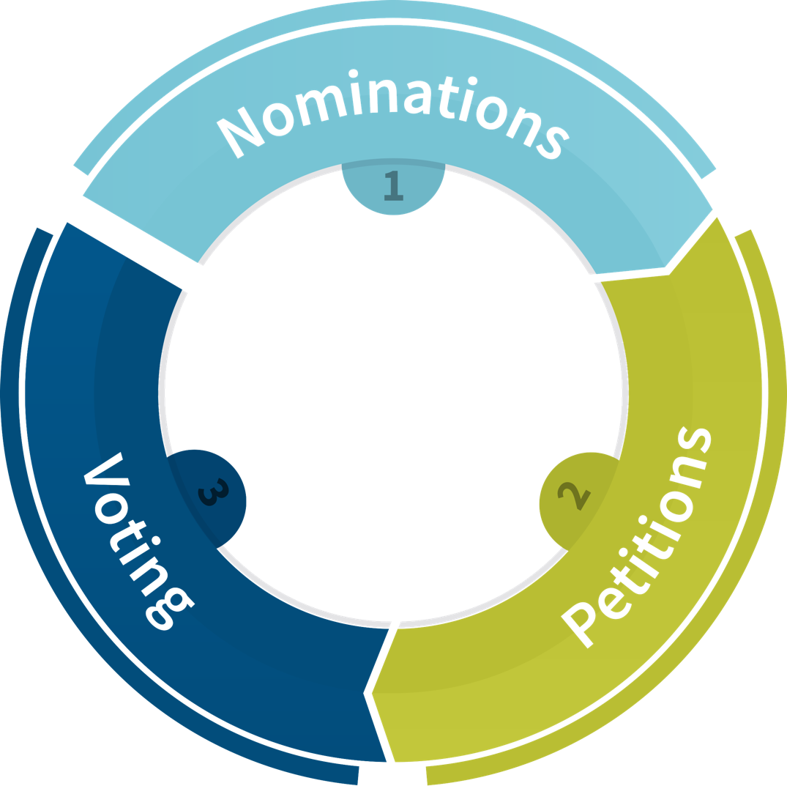
Our Elections Process

Slide 10
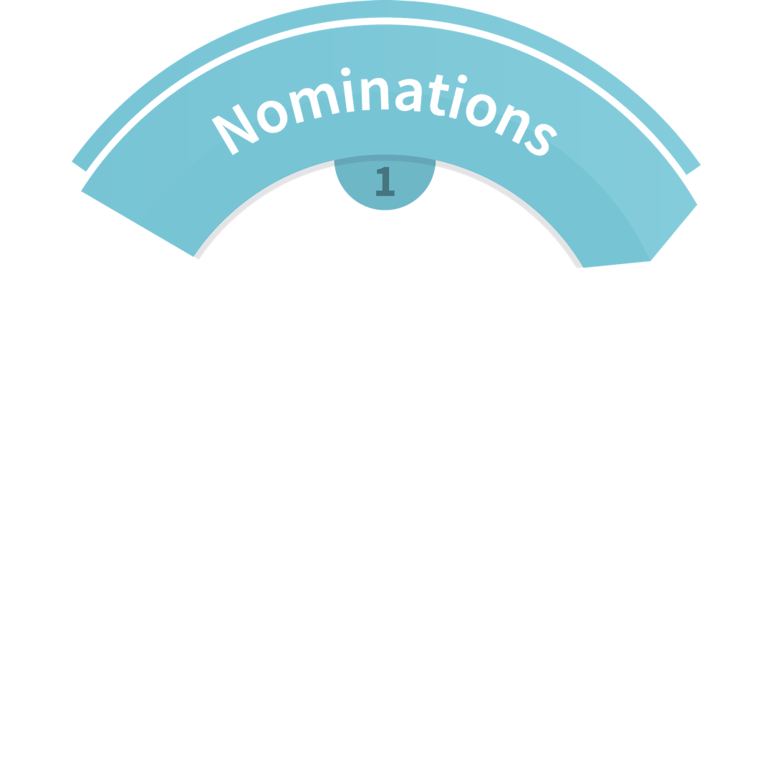

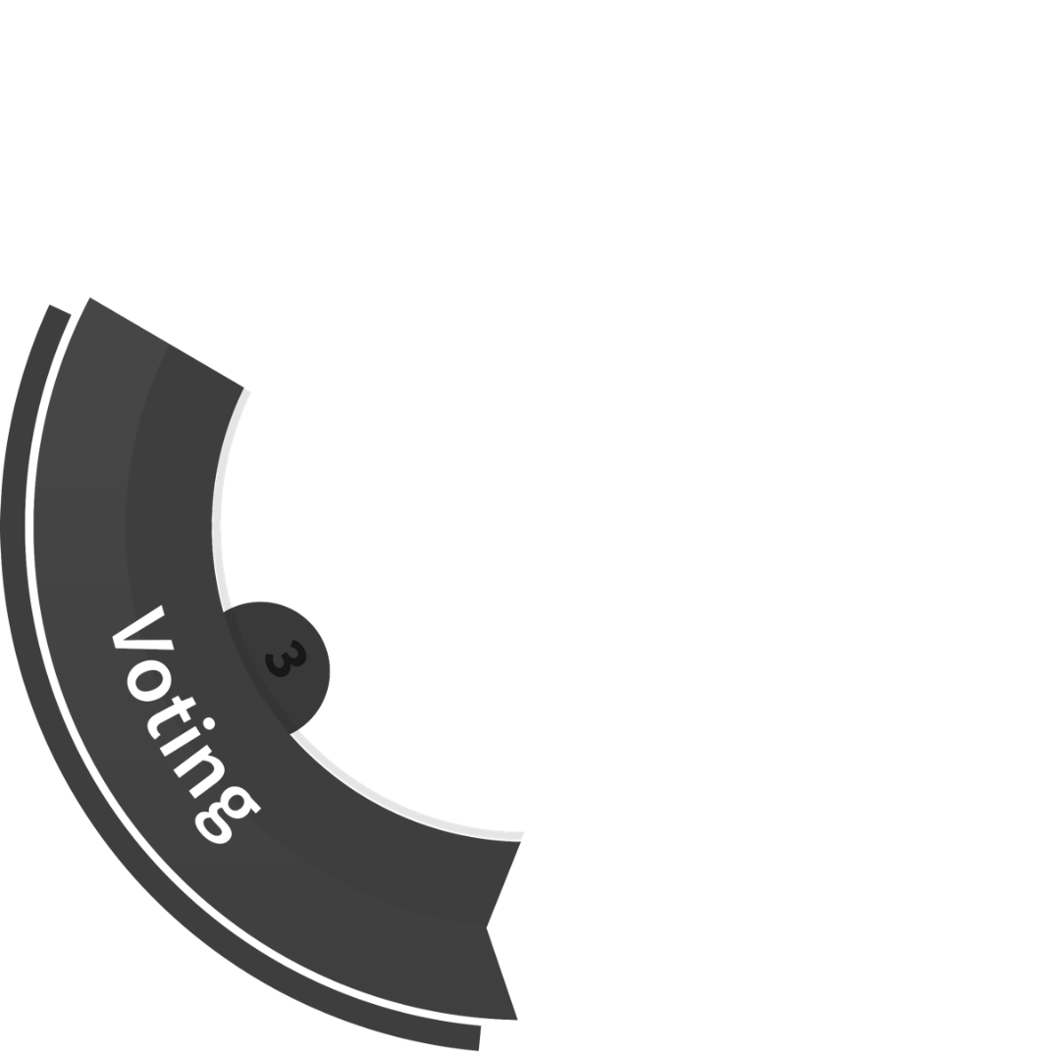
Nominations

Slide 11
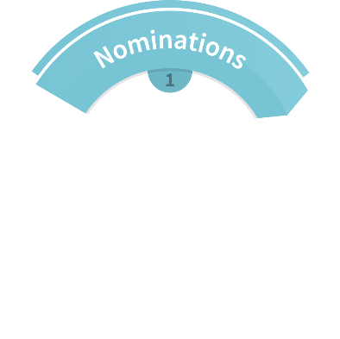

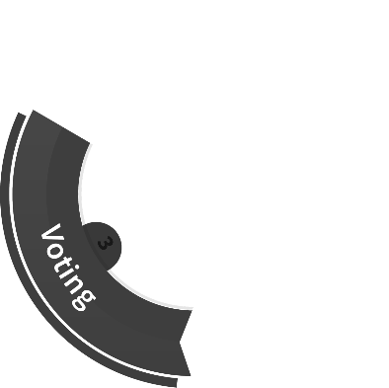


Nominations: Criteria
The Governance and Policy Committee and Nominating Committee identify issues facing profession, based on SOA strategic initiatives and priorities
Both committees review and identify skills and criteria for the Board positions

Slide 12
Nominations: Criteria
The Nominating Committee looks at geographic locations and practice areas of Board members
The Nominating Committee determines if reserved seats are needed for the Board and makes recommendations to the Board for approval
The Governance and Policy Committee and the Board seek out potential candidates who can provide the skills and experience needed in the SOA's leadership positions

Slide 13
Nominations:
Call for Submissions
Notice of the Board election is posted on SOA.org and in the SOA News Weekly e-newsletter
Any FSA can submit their name for consideration
The Board, Issues Advisory Committee, Strategic Action Teams, sections, committee chairs and employers should encourage member leaders to submit names of FSAs with the required skills and experience

Slide 14


Nominations: Interview
Nominating Committee reviews the submissions
Nominees complete questionnaire covering experience, strategic thinking, core competencies and teamwork skills
The Board provides feedback on nominees
Nominating Committee Chair and Vice Chair also interview Leadership Team members for feedback on the nominees

Slide 15

Nominations: Review
Nominating Committee reviews the questionnaires and interview results
  Looks at skills and criteria to determine election ballot
  Identifies “best set” of strongest candidates for endorsement
Committee submits the ballot to the Board for approval (June Board meeting)
Committee notifies all candidates as to who is endorsed for the ballot

Slide 16

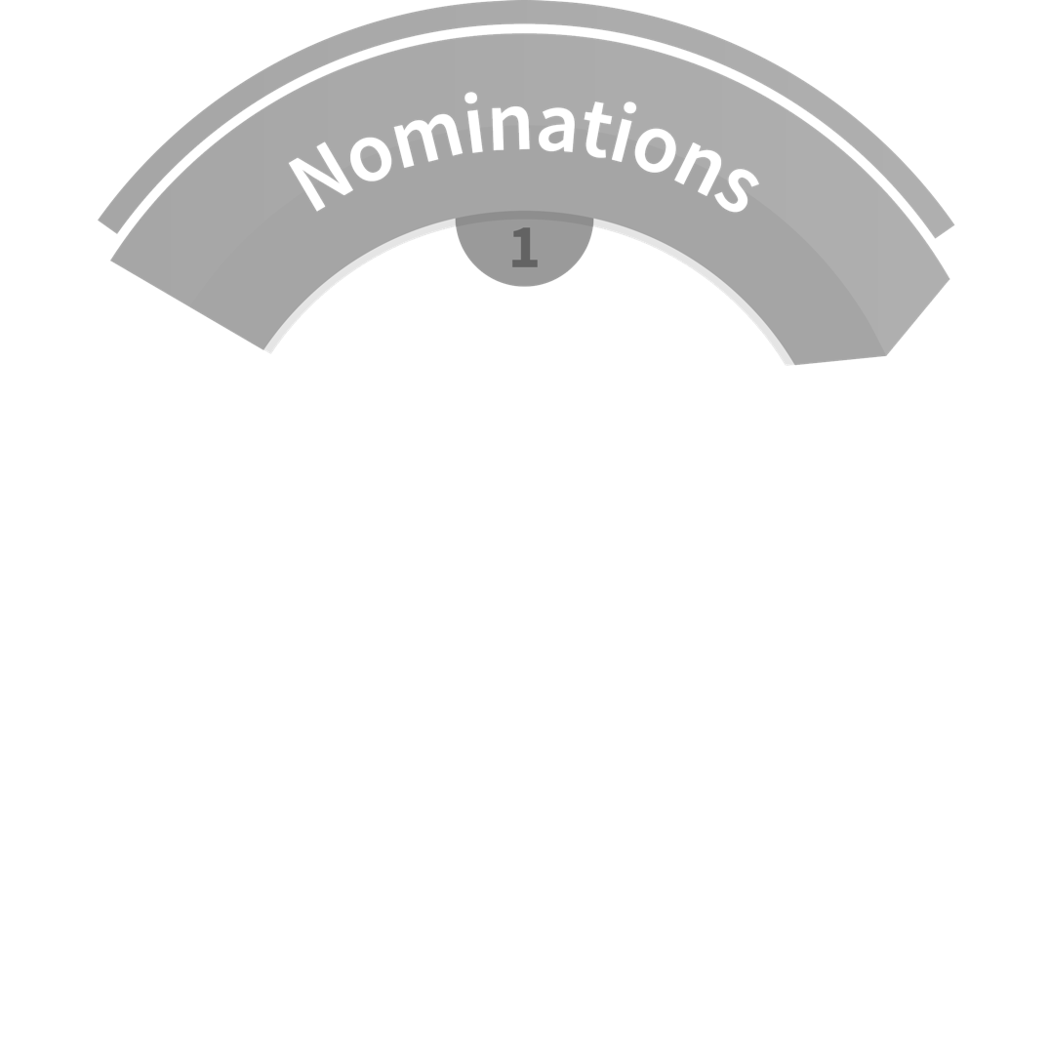
Petitions

Slide 17


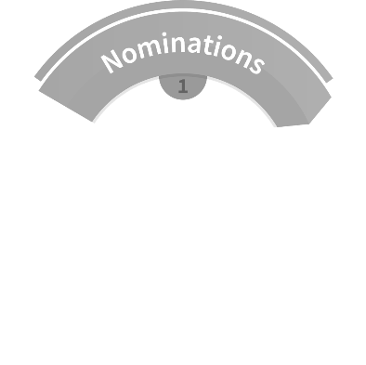


Petitions: Qualify by Petition
Nominees who have not been endorsed can seek petition support
To qualify for the ballot by petition, nominees must obtain petition support equivalent to at least 10 percent of votes cast for president-elect in the previous year’s election

Slide 18

Petitions: Member Support
The nominees notify the Nominating Committee about the position for which they seek petition support
An independent vendor manages the petition process
Eligible voting members receive an email to support a petition
Petition support is optional and anonymous

Slide 19

Petitions: Next Steps
The Nominating Committee receives the petition process results
Nominees who receive the required level of petition support are added to the final ballot

Slide 20
Finalizing Ballot for Voting
Endorsed Candidates
Candidates by Petition
Final Ballot

Slide 21


Voting

Slide 22



Voting: Slate
The SOA announces the final slate of candidates on the ballot
The SOA posts candidates’ election questionnaire, candidate webpage and message to members
Two emails are sent to members on behalf of the president-elect candidates
Members can view candidates’ information at SOA.org/elections

Slide 23
Voting: Election Voting Open
The election is open from late August
to early September each year
Eligible members receive ballots
  Via email with confirmed email address
  Via mail if no confirmed email on file
Voting is confidential and anonymous
An independent vendor manages the ballot voting

Slide 24
Voting: Results
Certified results are available several days after the elections voting closes
The election results are sent to a team of SOA leaders to review and verify the elections results
Candidates are notified of the results
Election results are communicated to members through an announcement and other SOA communications

Slide 25
Voting: Other Facts
During elections voting, there can also be voting on specific bylaw changes or additions
The president-elect takes office in October during the Annual Meeting & Exhibit
New Board members participate in training sessions in the fall each year
Elected presidents serve different roles over time: president-elect, president and past president

Slide 26



Additional Questions
Contact us with any questions at elections@soa.org

Slide 27
Visit www.SOA.org/elections

